Slide 1
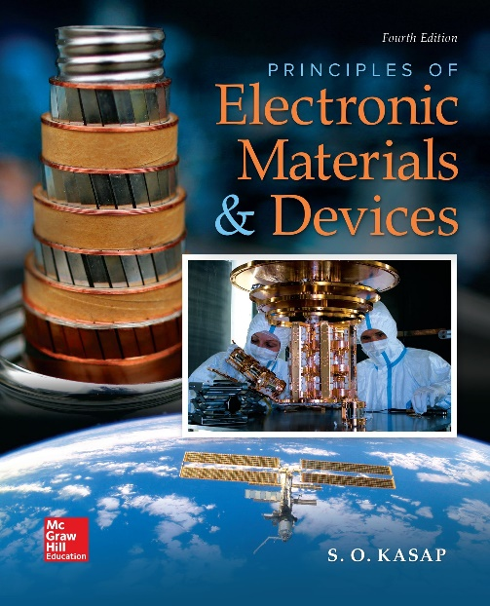
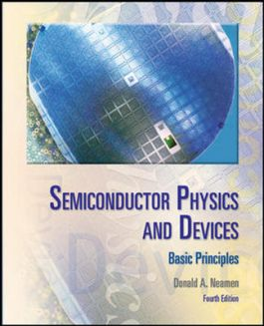

ELECTRONIC MATERIALS AND DEVICES
L | T | P | J | C
3 | 0 | 0 | 0 | 3
Dr. M. Saranya Nair
School of Electronics Engineering
VIT-Chennai Campus
E-mail : saranyanair.m@vit.ac.in
Revision

Slide 2
ELECTRONIC MATERIALS AND DEVICES
MODULE 1
Electrical and Thermal conduction in Solids
Crystalline state – Crystalline defects – Single Cyrstal Growth -Czochralski Growth – Amorphous Semiconductor - Classical Theory: Drude Model – Temperature dependence of resistivity – The Hall Effect and Hall Devices – Thermal conduction – Electrical conductivity of non-metals – Skin Effect – Thin metal films

Slide 3
Introduction to Solids – Qualitative
COVALENTLY BONDED SOLIDS: DIAMOND
METALLIC BONDING: COPPER
IONICALLY BONDED SOLIDS: SALT

Slide 4
Crystalline State – Simple Cubic, FCC, BCC, HCP
Problems

Slide 5
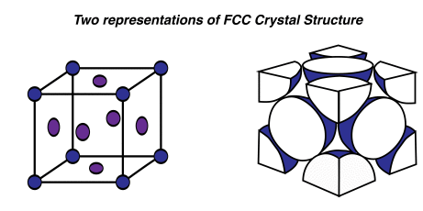
Consider the FCC unit cell of the copper crystal a. How many atoms are there per unit cell? b. If R is the radius of the Cu atom, find the lattice parameter a. c. Calculate the atomic packing factor (APF) d. Calculate the atomic concentration (number of atoms per unit volume) in Cu and the density of the crystal given that the atomic mass of Cu is 63.55 g mol−1 and the radius of the Cu atom is 0.128 nm.
APF =Volume of atoms in unit cell / Volume of unit cell
n_{at} = Number of atoms in unit cell / Volume of unit cell
ρ = Mass of all atoms in unit cell / Volume of unit cell

Slide 8
Relation : a vs R for different Unit cell Structures

Slide 9
CRYSTALLINE DEFECTS AND THEIR SIGNIFICANCE Qualitative Explanation

Slide 10


ELECTRICAL AND THERMAL CONDUCTION IN SOLIDS CLASSICAL THEORY: THE DRUDE MODEL
J_{x} = env_{dx}

Slide 11

ELECTRICAL CONDUCTIVITY OF NONMETALS

Slide 12
Calculate the drift mobility of conduction electrons in copper at room temperature, given that the conductivity of copper is 5.9 × 10⁵ Ω⁻¹ cm⁻¹. The density of copper is 8.96 g cm⁻³ and its atomic mass is 63.5 g mol⁻¹.
2. A silicon semiconductor resistor is in the shape of a rectangular bar with a cross sectional area of 8.5 x 10⁻⁴ cm², a length of 0.075 cm, and is doped with a concentration of 2 x 10¹⁶ cm⁻³ boron atoms. Let T = 300 K. A bias of 2 volts is applied across the length of the silicon device. Calculate the current in the resistor. Determine the average drift velocity of holes.
3. Consider the BCC unit cell of the Chromium crystal
a. How many atoms are there per unit cell.
b. Calculate the atomic packing factor (APF) if the lattice parameter is 2.3 times of the atom’s radius.
c. Calculate the atomic concentration (number of atoms per unit volume) in Cr, given that the atomic mass of Cr is 51.99 g mol⁻¹ and the radius of the Cr atom is 1.25 Angstrom.

Slide 13
4. Chromium has BCC crystal structure, density 7.3 g/cubic cm, atomic mass 51.99 g/mol. Determine lattice parameter, atomic radius and atomic concentration.
5. Aluminium has FCC crystal structure, radius 118 pm, atomic mass 26.98 g/mol. Determine number of Al atoms per unit volume.
6. A n-type Silicon has conductivity 2 S/m. Determine hole & electron concentration. Find the change in conductivity if a heat source provides 2 x 10¹⁵ electron-hole pairs/ cubic cm.

Slide 14
ELECTRONIC MATERIALS AND DEVICES
MODULE 2
Semiconductor Fundamentals
Introduction to Solids, Crystals, and Electronic materials – Formation of energy bands – Energy band Model – Effective mass - Direct and indirect bandgap – Elemental and compound semiconductors, Intrinsic and extrinsic semiconductors. The density of states, Carrier statistics, Fermi level, Equilibrium carrier concentration, Quasi-equilibrium, and Quasi-Fermi level.

Slide 15
Semiconductors – Qualitative Study
Intrinsic type
Extrinsic type
Formation of Energy Bands
Electron Effective Mass
Metals, Insulators, and Semiconductors
Fermi Level
Effective Density of States

Slide 16
Equilibrium Distribution of Electrons and Holes – Problems

Slide 17
1. Calculate the thermal-equilibrium hole concentration in silicon at T = 400 K. Assume that the Fermi energy is 0.27 eV above the valence-band energy.
2. Calculate the thermal equilibrium concentrations of electrons and holes for a given Fermi energy. Consider silicon at T = 300 K, Assume that the Fermi energy is 0.22 eV below the conduction band.
3. Determine the thermal-equilibrium concentrations of electrons and holes in silicon at T = 300 K if the Fermi energy level is 0.215 eV above the valence-band energy

Slide 18
The Intrinsic Carrier Concentration - Derivation
Problem : Calculate the intrinsic carrier concentration in silicon at T = 300 K.
Qualitative Study :Energy Band Structures
Intrinsic / Extrinsic Semiconductor
Direct & Indirect Bandgap Semiconductor

Slide 19
ELECTRONIC MATERIALS AND DEVICES
MODULE 3
Carrier Transport Mechanism
Charge carriers in semiconductors – Drift and Diffusion of carriers – Mobility – Generation, Recombination and injection of carriers – Carrier transport equations – Excess carrier lifetime.

Slide 20
Problems
Drift Current, Diffusion Current, Total Current
Einstein Relation
Mobility Effects – Qualitative Study
Excess Carrier Concentration – 2 Equations
Diffusion Length
Recombination Rate
Practice all problems solved in class

Slide 21
ELECTRONIC MATERIALS AND DEVICES
MODULE 4
Junction diodes

Slide 22
PN Diode – Qualitative Study
Basic Structure
Zero Bias – Derivation for V_{bi}, x_{n}, x_{p} & W
Expressions for Forward & Reverse Bias
Junction Breakdown
MS Contacts – Band Structure under Different Biasing, Comparison with PN Diode

Slide 23
PN Diode – Problems
Problems related to V_{bi}, x_{n}, x_{p} & W for all Biasing (Problems solved in class)
Forward Current Problems
Junction Capacitance Problems
One-sided Junctions Problems

Slide 24
ELECTRONIC MATERIALS AND DEVICES
MODULE 5
Bipolar Junction Transistor

Slide 25
BJT – Detailed Study
Basic Structure, Symbol, Doping Profile, Band Structure
Modes of Operation
Minority Carrier Distribution & Current Components
Transistor CE Characteristics
Study for both npn & pnp

Slide 26
BJT – Problems
Load Line & Q –Point
Hard Satuartion
Other Problems solved in class

Slide 27
ELECTRONIC MATERIALS AND DEVICES
MODULE 6
Field Effect Transistor

Slide 28
MOSCAP – Detailed Study
Basic Structure
Formation of Accumulation layer
Formation of Space Charge Region
Energy Band Diagrams – Flat Band, Accumulation Layer, Inversion Layer, Band Bending
Depletion Layer Width – Problem
Study for both n-type & p-type semiconductor

Slide 29
MOSFET – Detailed Study
Basic Structure & Symbol
Difference between n/p channel enhancement / depletion mode MOSFET
Basic Operation in Enhancement Mode MOSFET
C-V Characteristics
Saturation & Non-Saturation Regions
Study for both n-channel & p-channel

Slide 30
Thank you

